Slide 1

MongoDB
Dima Ionut Daniel

Slide 2
Contents
What is MongoDB?
History
Features
Core
Operators
Data Types
Indexes
Aggregation
Security
Sharding
Transactions
Conclusions
Bibliography

Slide 3

What is MongoDB?
MongoDB is a cross-platform document-oriented database program, classified as a NoSQL database.
MongoDB uses JSON-like documents with schema, under the Server Side Public License (SSPL).

Slide 4
History
10 gen software company began developing MongoDB in 2007 as a component of a planned platform as a service product.
In 2009 the company shifted to an open source development model, offering commercial support and other services.
In 2013, 10gen changed its name to MongoDB Inc.

Slide 5
Features
Ad hoc queries: MongoDB supports field, range query and regular expression searches.
Indexing: fields in a MongoDB document can be indexed with primary and secondary indices.
Replication: MongoDB provides high availability with replica sets. Each replica set member may act in the role of primary or secondary replica at any time.
Load balancing: MongoDB scales horizontally using sharding. The user chooses a shard key, which determines how the data in a collection will be distributed. The data is split into range and distributes across multiple shards.

Slide 6
Features (cont.)
File storage: MongoDB can be used as a file system, called GridFS, with load balancing and data replication features over multiple machines for storing files
Aggregation: MongoDB provides 3 ways to perform aggregation: pipeline, map-reduce function and single-purpose aggregation methods.
Server-side Java Script execution: can be used in queries, aggregation functions (as MapReduce) and sent directly to the DB to be executed.
Transactions: support for multi-document ACID transactions

Slide 7
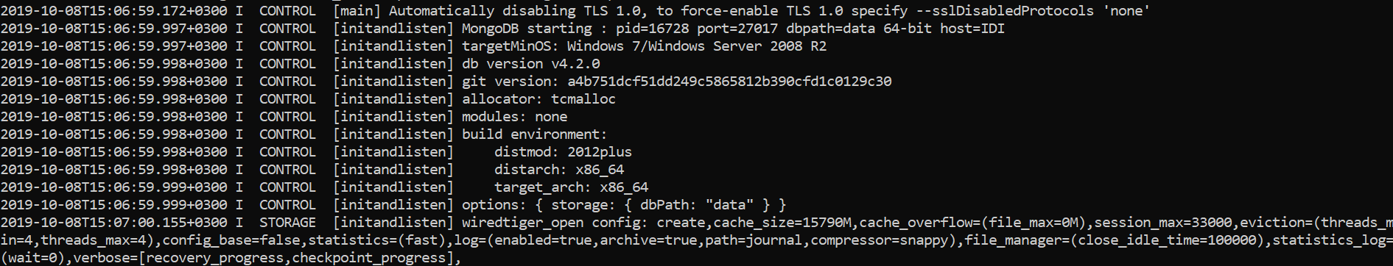
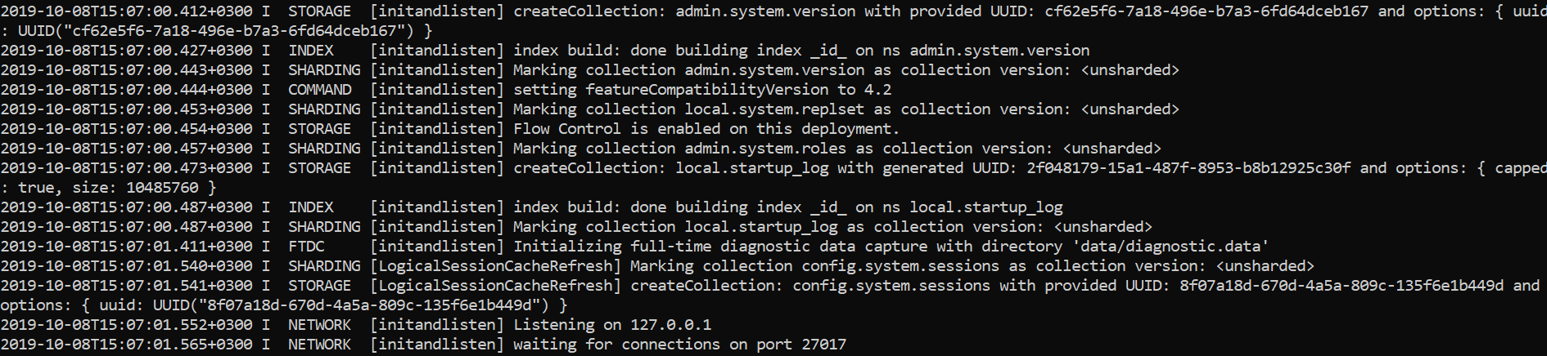
Core
MongoDB needs to store the database date somewhere.
On macOS, Linux, MongoDB by default uses /data/db as the storage path, on windows C:\data\db
On Windows we can change the path as mongod --dbpath "my/new/path".
MongoDB will boot with default port 27017.

Slide 8
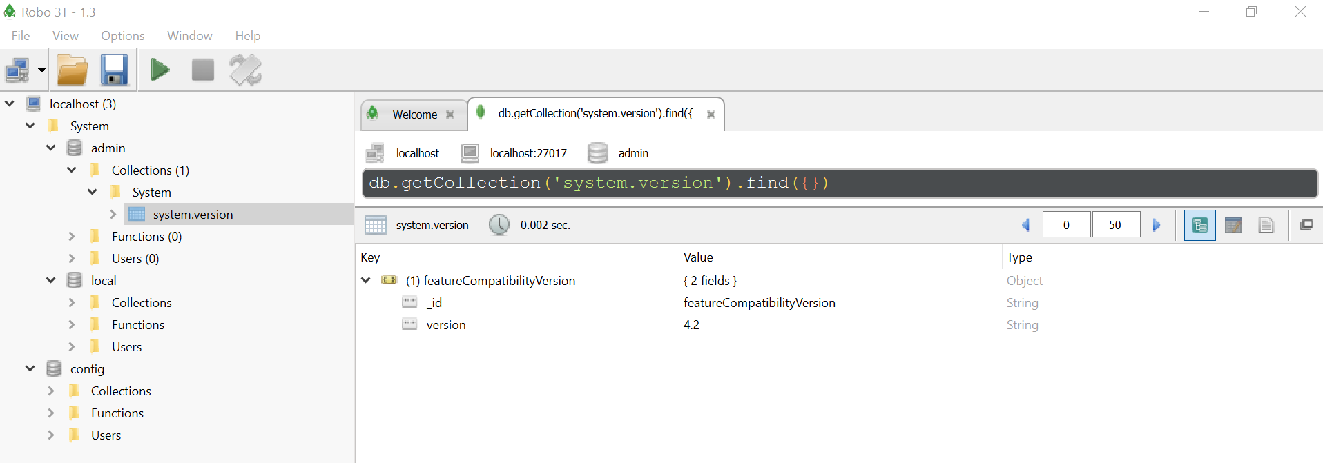
Core (cont.)
Practical IDEs:
Studio 3T for Mongo DB
Robo 3T
NOSQL Booster

Slide 9
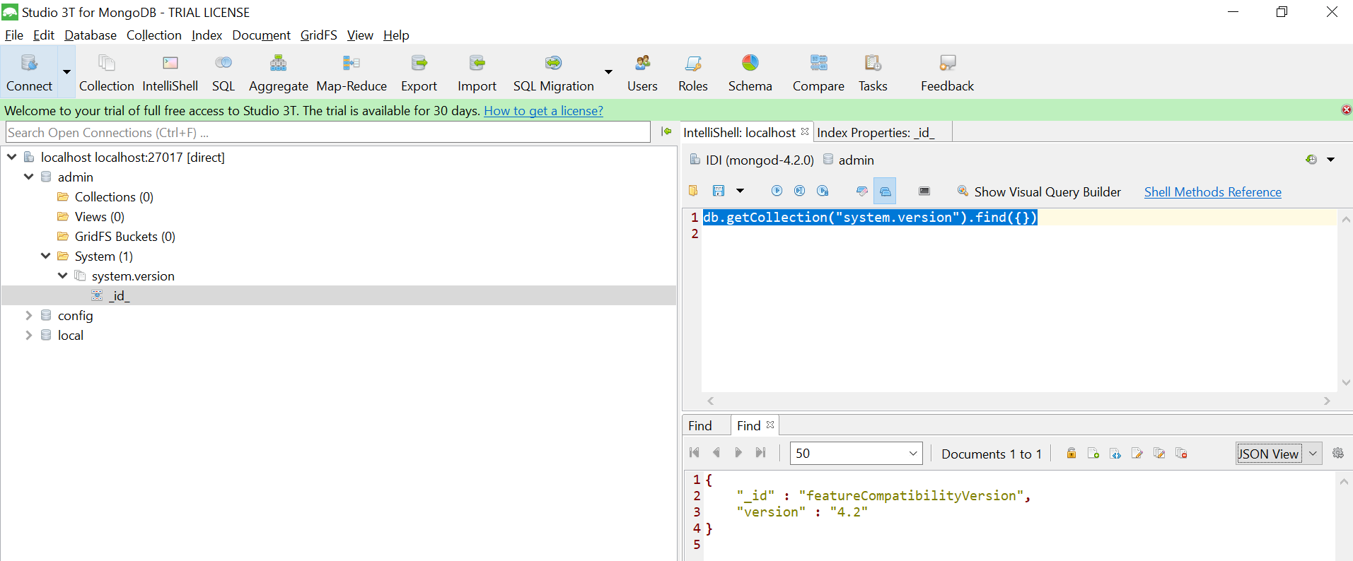
Core (cont.)

Slide 10
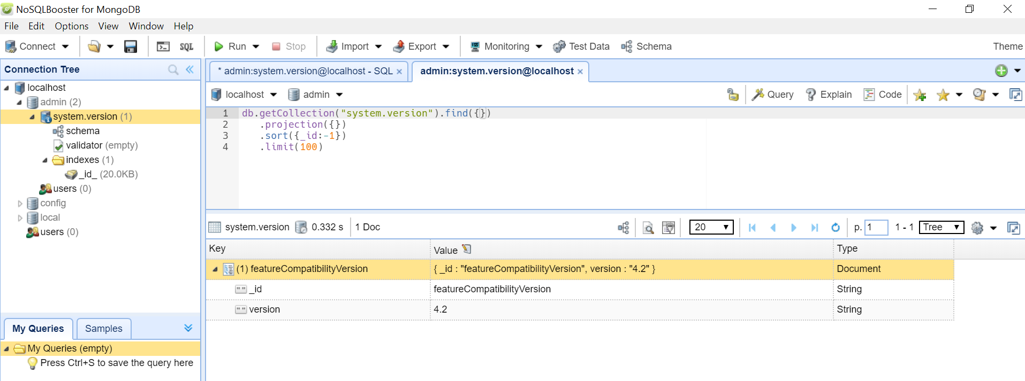
Core (cont.)

Slide 11
Core (cont.)
We can use mongo shell command to connect to MongoDB.
show dbs command will display existent databases
use db_name is used to switch to certain database
db.<collection_name>.insertOne({name: "kenshin"}) will add a JSON document into the new created collection
db.<collection_name>.find() returns all the data for that collection
db.<collection_name>.find().pretty() return the data for that collection nicely formatted
db.<collection_name>.delete(filter) deletes documents using a JSON filter with key/value.
db.<collection_name>.updateOne(filter, data) updates an existent document if found.
db.dropDatabase() drops the current selected database
db.stats() shows information about database

Slide 12
Core (cont.)
JSON is an open-standard file format that uses human-readable text to transmit data objects consisting of attribute-value pairs and array data types.
JSON is a language-independent data format, derived from JavaScript.
It's a very common data format, with a diverse range of applications, such as serving as replacement for XML in Ajax systems.
MongoDB doesn't enforce schemas. Documents don't have to use the same schema inside of one collection.

Slide 13
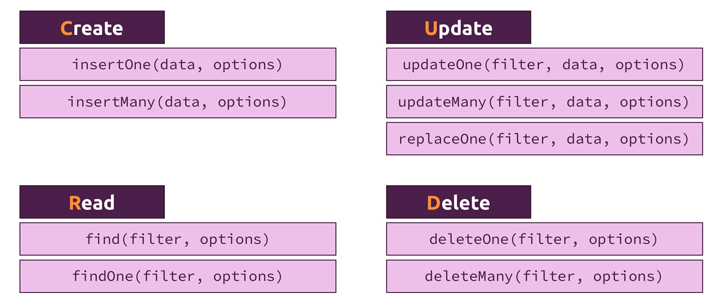
Core (cont.)
CRUD operations

Slide 14
Core (cont.)
Write concern describes the level of acknowledgement requested from MongoDB for write operations.
Write concern can include the following fields: {w: <value>, j: <boolean>, wtimeout: <number>}
The j option requests acknowledgement from MongoDB that the write operation has been written to the on-disk journal
If j is set to true, request acknowledgement have written on-disk journal, otherwise it's written in memory.

Slide 15
Core (cont.)
We can import json documents using the mongoimport command.
-d argument specifies the new database name
-c argument specifies the collection name
--jsonArray arguments specifies that the JSON file has an array of documents
Example: mongoimport persons.json –d analytics –c persons --jsonArray

Slide 16
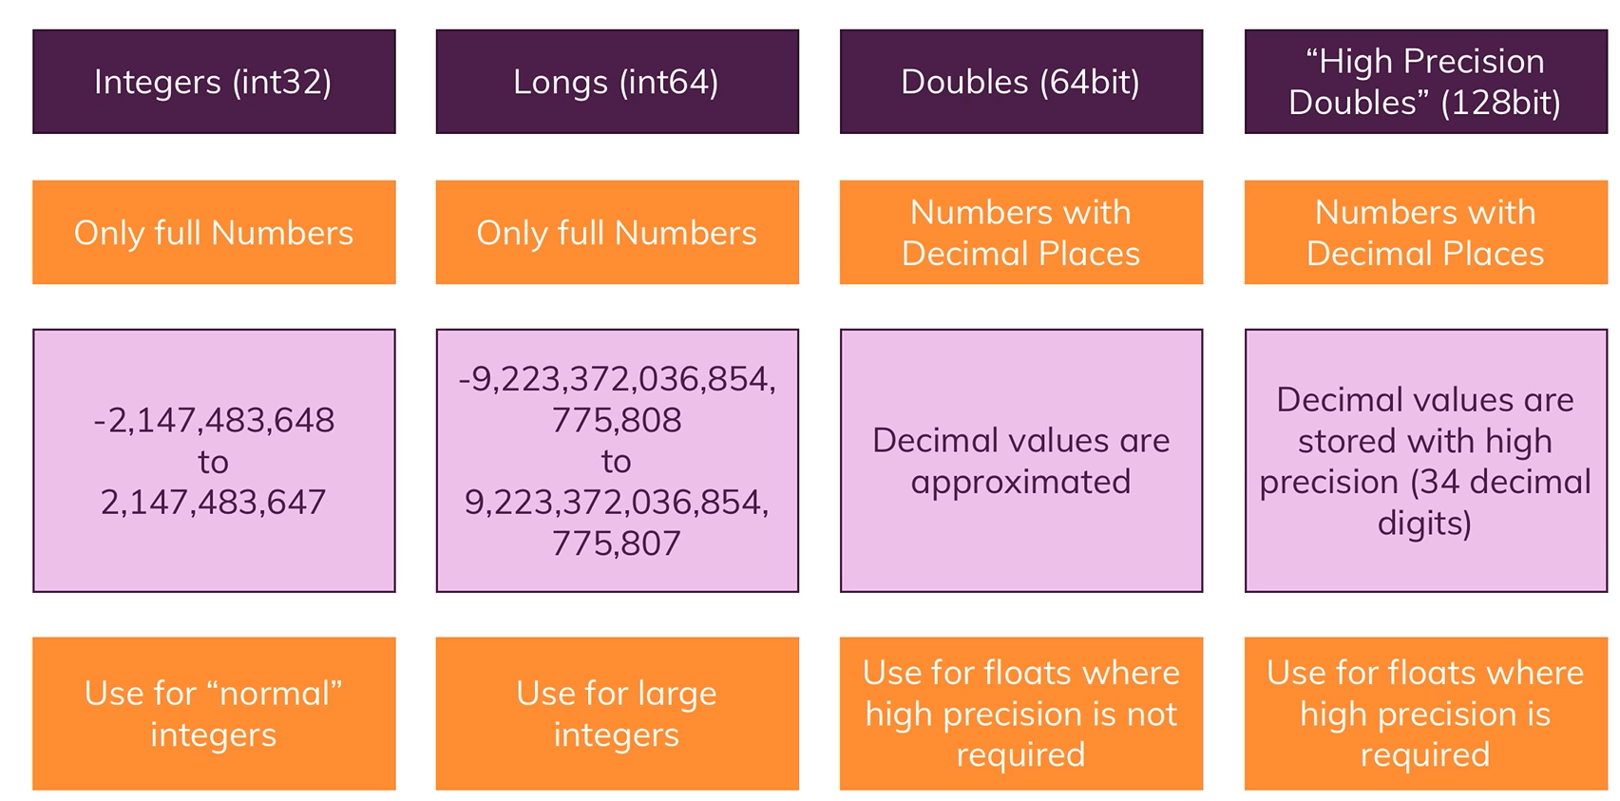
Core (cont.)
Working with numbers:

Slide 17
Operators
Query operators:
$eq: matches values that are equal to a specified value
$gt: matches values that are greater than a specified value
$gte: matches values that are greater than or equal to a specified value
$in: matches any of the values specified in an array
$lt: matches values that are less than a specified value
$lte: matches values that are less than or equal to a specified value
$ne: matches all values that are not equal to a specified value
$nin: matches none of the values specified in an array

Slide 18
Operators (cont.)
Logical operators:
$and: joins query clauses with a logical AND
$not: inverts the effect of a query expression
$nor: joins query clauses with a logical NOR
$or: joins query clauses with a logical OR

Slide 19
Operators (cont.)
Element operators:
$exists: matches documents that have the specified field
$type: selects documents if a field is of the specified type
Array operators
$all: matches arrays that contain all elements specified in the query
$elemMatch: selects documents if element in the array field matches all the specified conditions
$size: selects documents if the array is a specified size

Slide 20
Operators (cont.)
Update operators:
$currentDate: sets the value of a field to current date, either as a Date or a Timestamp
$inc: increments the value of the field by the specified amount
$min: only updates the field if the specified value is less than the existing field value
$max: only updates the field if the specified value is greater than the existing field value
$mul: multiplies the value of the field by the specified amount
$rename: renames a field
$set: sets the value of a field in a document
$unset: removes the specified field from a document

Slide 21
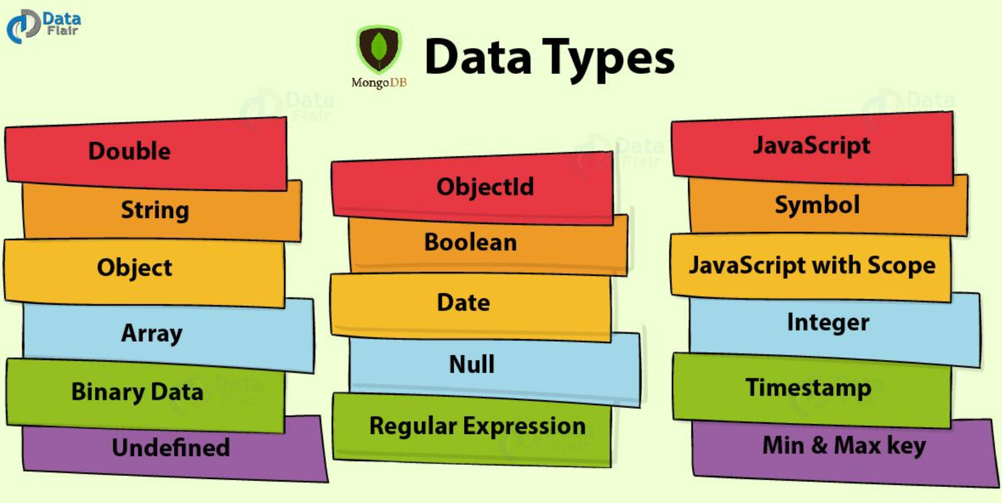
Data Types
There are 16 data types in MongoDB

Slide 22
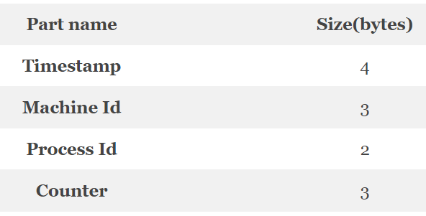
Data Types (cont.)
MongoDB stores documents in BSON, which is the binary encoded format of JSON.
The BSON data format provides various types, used when we store the JSON objects in the binary form.
The ObjectId data type in MongoDB stores the unique key id of documents stores. The size of ObjectId is 12 bytes which are divided into 4 parts.

Slide 23
Indexes
Indexes support the efficient execution of queries in MongoDB.
Without indexes, MongoDB must perform a collection scan, i.e. scan every document in a collection, to select those that match the query statement.
If an appropriate index exists for a query, MongoDB can use the index to limit the number of documents it must inspect.

Slide 24
Indexes (cont.)
Indexes are special data structure that sore a small portion of the collection's data set in an easy to traverse form.
MongoDB creates a unique index on the _id field during the creation of a collection.
The _id index prevents clients from inserting two documents with the same value for the _id field.
You cannot drop this index on the _id field.

Slide 25
Indexes (cont.)
db.collection.createIndex( <key and index type specification>, <options> )
The bellow example creates a single key descending index on the name field:
db.collection.createIndex( { name: -1 } )
We can view index names using the db.collection.getIndexes() method.
We cannot rename an index once created, instead we must drop and re-create the index with a new name.

Slide 26
Indexes (cont.)
MongoDB provides different index types to support specific types of data and queries.
Single Field
Compound Index
Multikey Index
Geospatial Index
Text Index
Hashed Index

Slide 27
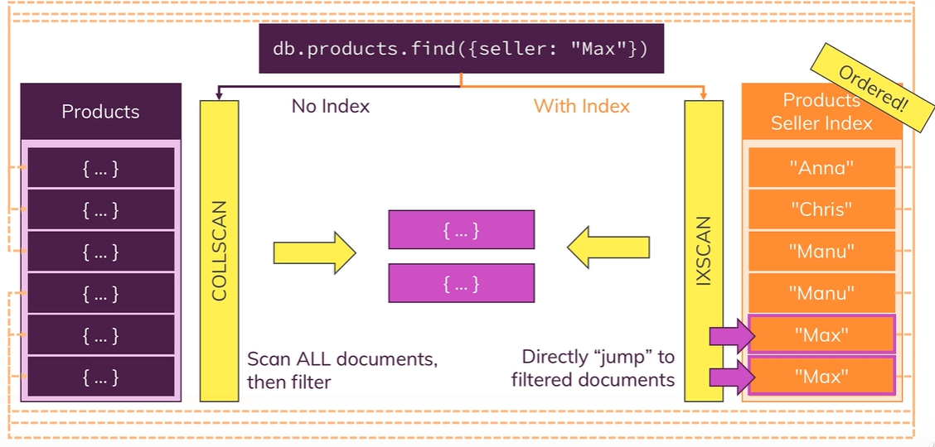
Indexes (cont.)

Slide 28
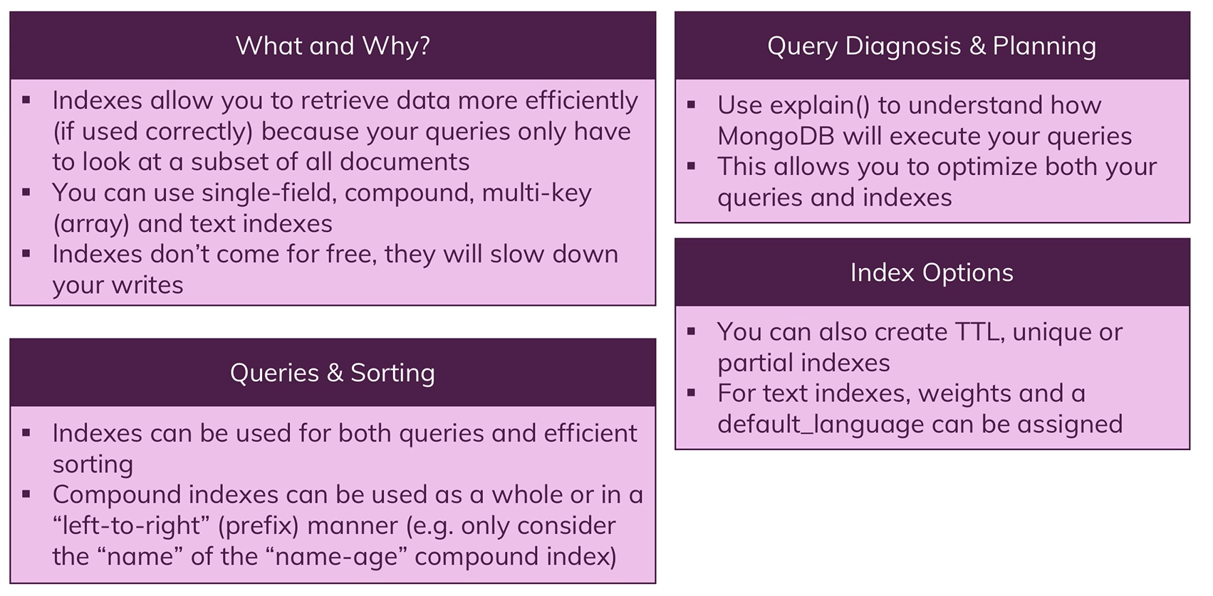
Indexes (cont.)

Slide 29
Aggregation
Aggregation operations process data records and return computed results.
Aggregation operations group values from multiple documents together and can perform a variety of operations on the grouped data to return a single result.
MongoDB provides 3 ways to perform aggregation:
- aggregation pipeline
- map-reduce function
- single purpose aggregation methods

Slide 30
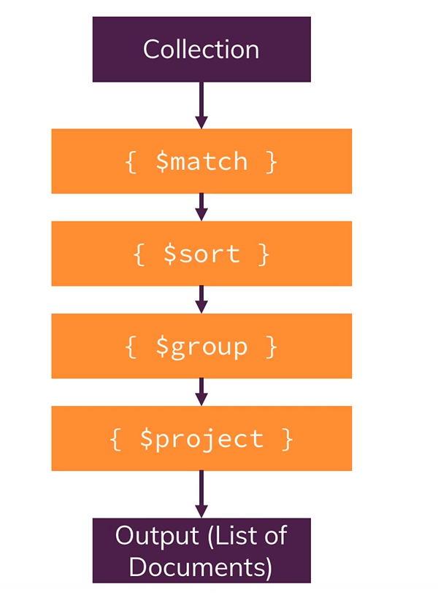
Aggregation (cont.)

Slide 31
Aggregation (cont.)
The aggregation pipeline is a framework for data aggregation modeled on the concept of data processing pipelines.
Documents enter a multi-stage pipeline that transforms the documents into aggregated results.
MongoDB aggregation pipeline consists of stages, each stage transforms the documents as they pass through the pipeline.

Slide 32
Aggregation (cont.)
Map-reduce is a data processing paradigm for condensing large volumes of data into useful aggregated results.
For map-reduce operations, MongoDB provides the mapReduce database command.

Slide 33
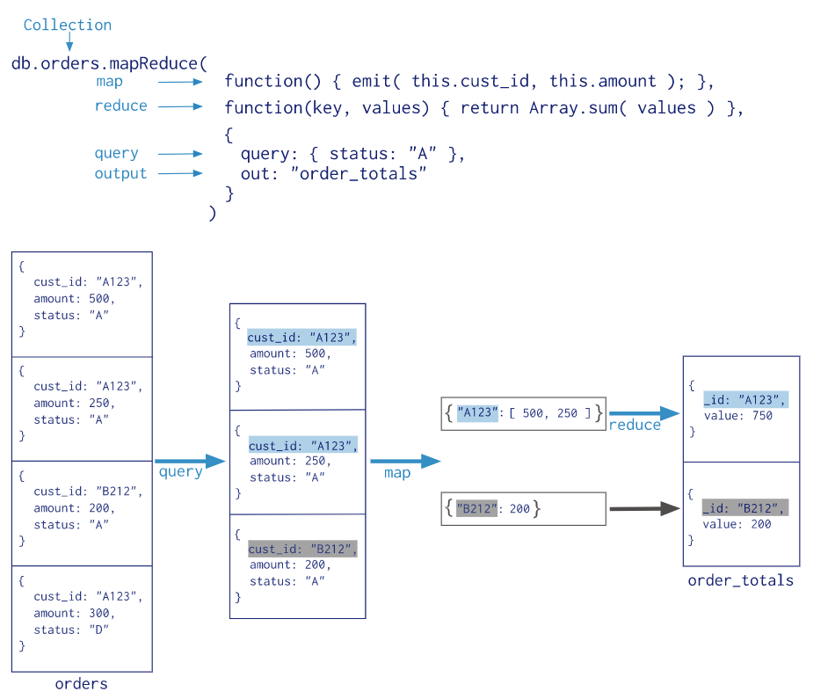
Aggregation (cont.)

Slide 34
Security
MongoDB provides various features, such as authentication, access control, encryption, to secure the deployment.
Authentication
Authorization
TLS/SSL

Slide 35
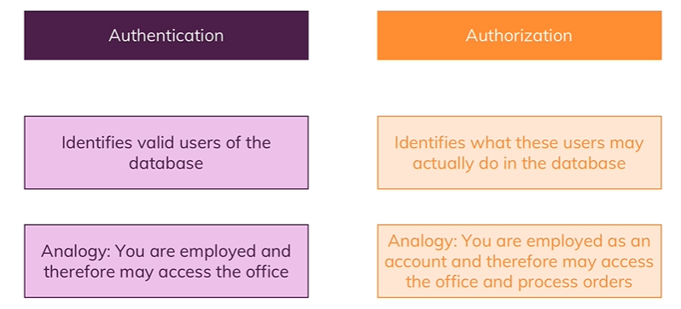
Security (cont.)

Slide 36
Security (cont.)
We can connect to localhost MongoDB host and use the command “use admin” to switch to admin mode.
We can create users with db.createUser( {user: “max”, pwd: “max”, roles: [“userAdminAnyDatabase”]} ) .
We can authenticate using “mongo –u user –p password” or db.auth(user, pass).

Slide 37
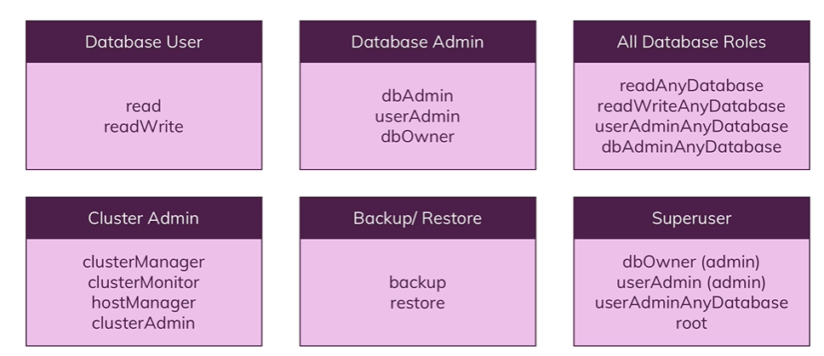
Security (cont.)
Built-in roles

Slide 38
Sharding
Sharding is a method for distributing data across multiple machines.
MongoDB uses sharding to support deployments with very large data sets and high throughput operations.
Database systems with large data sets or high throughput applications can challenge the capacity of a single server.

Slide 39
Sharding (cont.)
There are 2 methods for addressing system growth: vertical can horizontal scaling.
Vertical Scaling involves increasing the capacity of a single server: CPU, memory, storage.
Horizontal Scaling involves dividing the system dataset and load over multiple servers, adding additional servers to increase capacity as required.
MongoDB supports horizontal scaling through sharding.

Slide 40
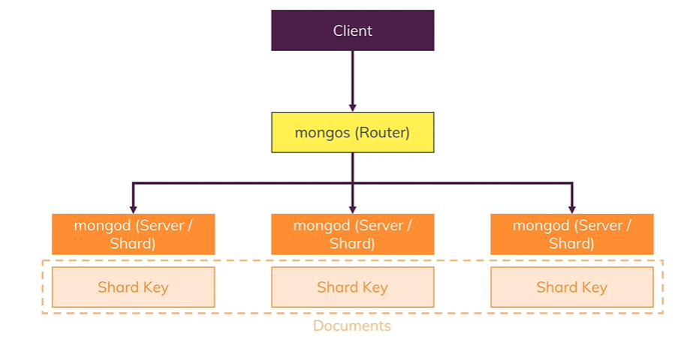
Sharding (cont.)

Slide 41
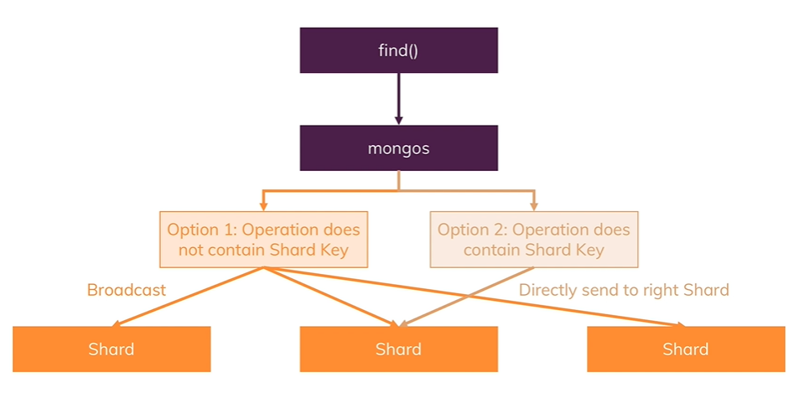
Sharding (cont.)

Slide 42
Transactions
In MongoDB an operations on a single document is atomic.
MongoDB supports multi-document transactions.
With distributed transactions, transitions can be used across multiple operations, collections, databases, documents and shards.

Slide 43
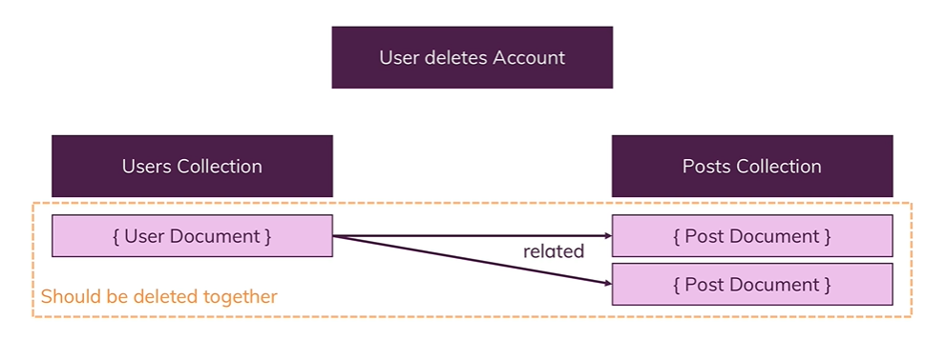
Transactions (cont.)
Example of transaction:

Slide 44
Transactions
We can start a transaction as: const session = db.getMongo().startSession()
Refer collections as: const posts = session.getDatabase("blog").posts
Start transaction: session.startTransaction()
Operate on collections: posts.deleteOne( <filter> )
Commit transaction: session.commitTransaction()

Slide 45
Conclusions
MongoDB is the most popular among the NoSQL databases.
It's a great tool for building data warehouses.
It's an open-source database withc makes it ideal for building high performance data warehouses.
It's well documented, well supported and easy to install and integrate with other langauges.

Slide 46

Bibliography
https://en.wikipedia.org/wiki/MongoDB
https://en.wikipedia.org/wiki/JSON
https://data-flair.training/blogs/mongodb-data-types/
https://docs.mongodb.com
MongoDB The complete Developers Guide - Udemy

